Slide 1
Introduction to ASP.NET MVC Core
Mvc (model, view, controller)

Slide 2
The web app components :
1- front end: an interface that allows users to interact with the system ” web app”( what you see and interact with).
2- back end: the system’s behaviors (what happens behind the scenes to make the front end work).

Slide 3
Types of developers:
1- SQL “DB developer”: interact with DB (design tables and their relationships .. etc.). ” not famous why”
2-front-end developer (client-side code): focus on building the user interface and experience (designing web pages.).
3- back-end developer (server-side code): handles the logic, databases, and server-side functionality that power the website or app.

Slide 4
Explain for ASP.Net :
ASP.Net: is a web framework, created by Microsoft, for building modern web apps and services with .Net.

Slide 5
Explain for MVC :
Model-View-Controller (MVC): design pattern that separates the web app into 3 main components(model, view, controller).

Slide 6
MVC Steps :
Incoming request is routed to a Controller (For web: HTTP request).
Controller processes requests and creates a presentation ( ModelController also selects appropriate result (view)).
Model is passed to View.
View transforms the Model into the appropriate output format (HTML).
Response is rendered (HTTP response).

Slide 7
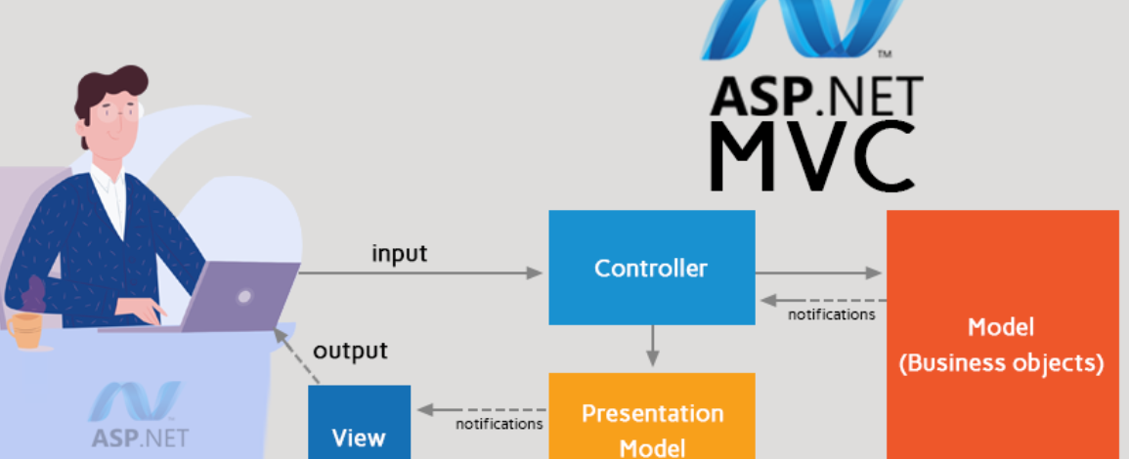
Presentation for MVC steps.

Slide 8
Controller
Handel user interface.
Select view to render.
Work with model.

Slide 9
Model
Represent any logic or operation.
Encapsulate concept is achieved.
Contains the viewmodel to represent part of a particular table ” in general any part of data.”.

Slide 10
View
Represent the content.
Contains minimal logic like if condition or simple looping “ advance does not contain any logic if can.”.
It is a UI ” user interface”.

Slide 11
The Tools
IDE: Visual Studio 2022
Framework: .NET Framework 8.0
Data: SQL Server 2022
Visual Studio installer will install everything we need

Slide 12
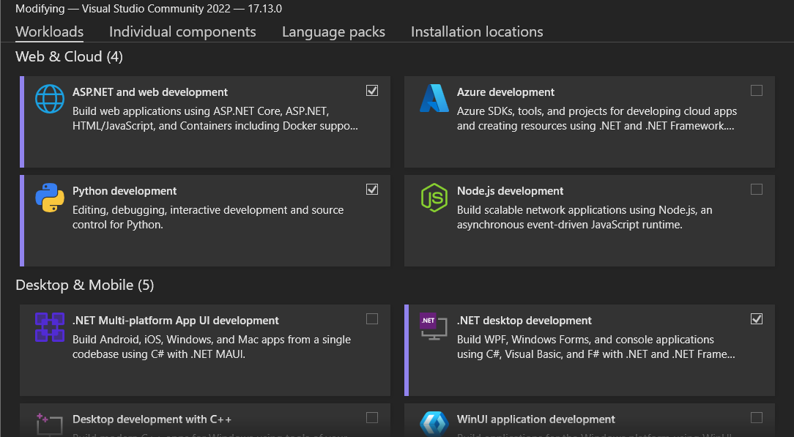
The visual studio installer install firstly then :

Slide 13
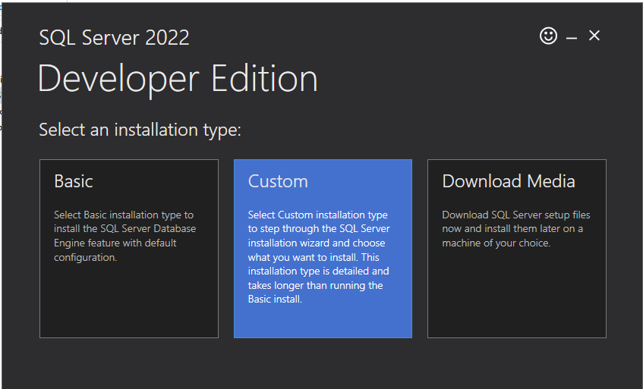
Install SQL SERVER 2022:

Slide 14
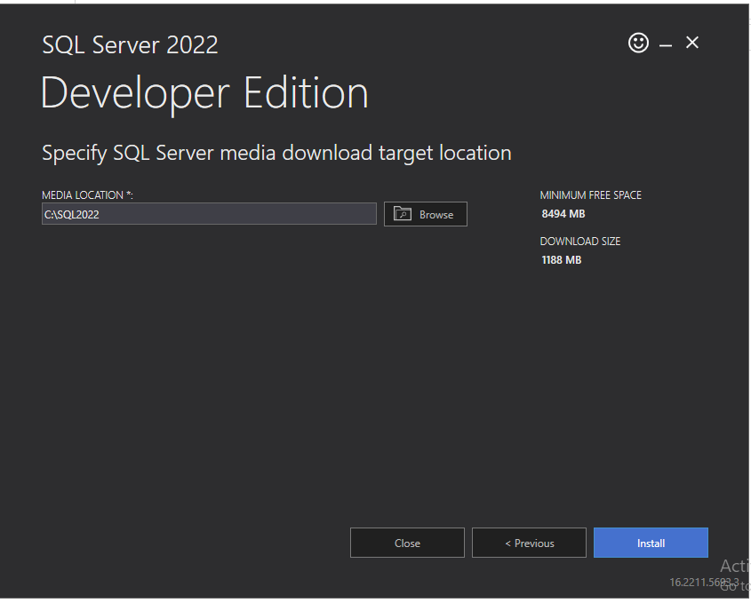

Slide 15
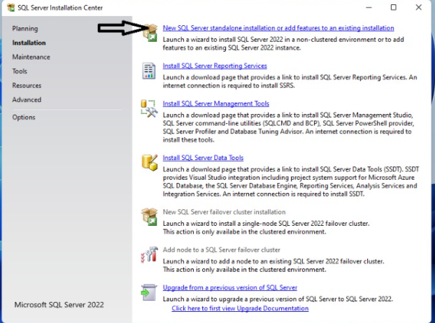

Slide 16
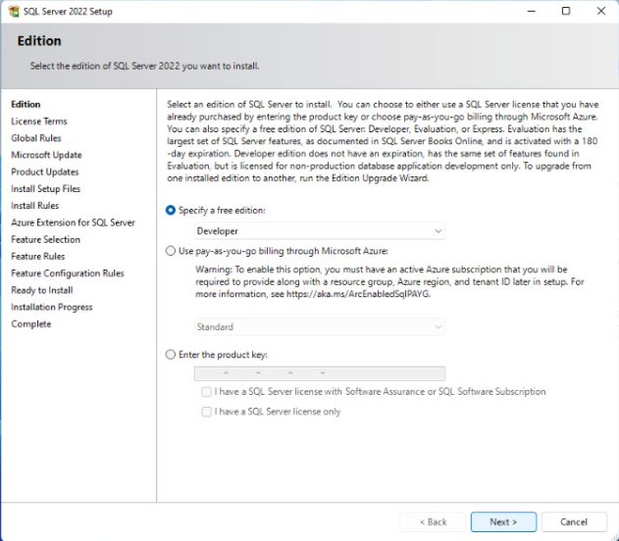

Slide 17
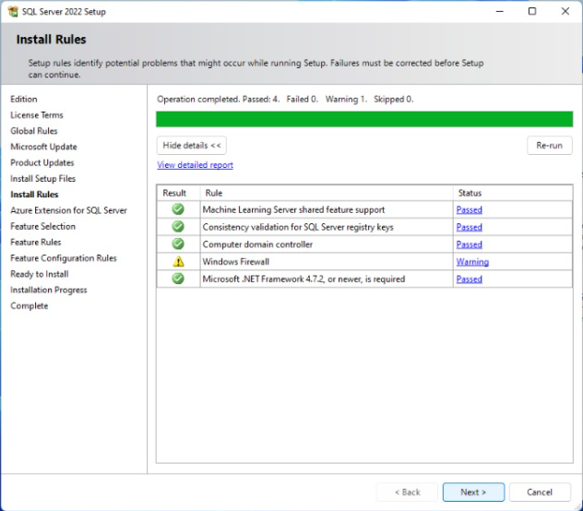

Slide 18
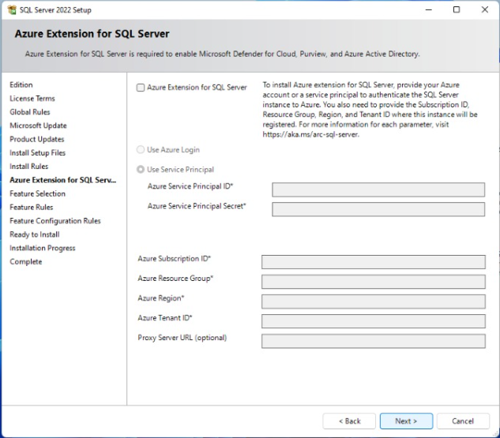


Slide 19
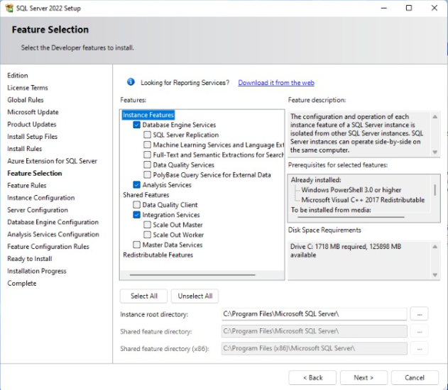

Slide 20
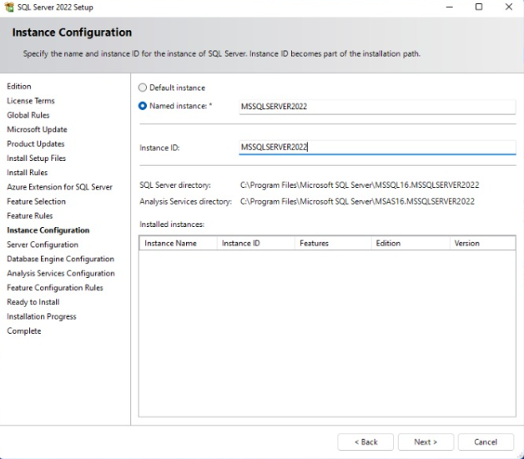

Slide 21
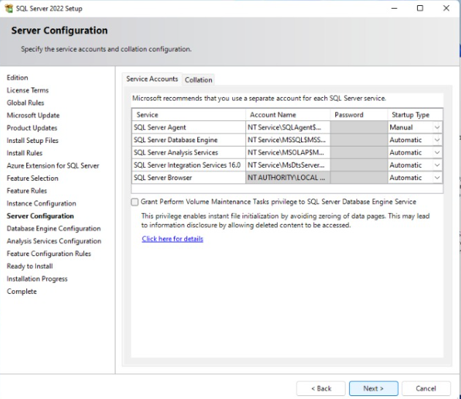

Slide 22
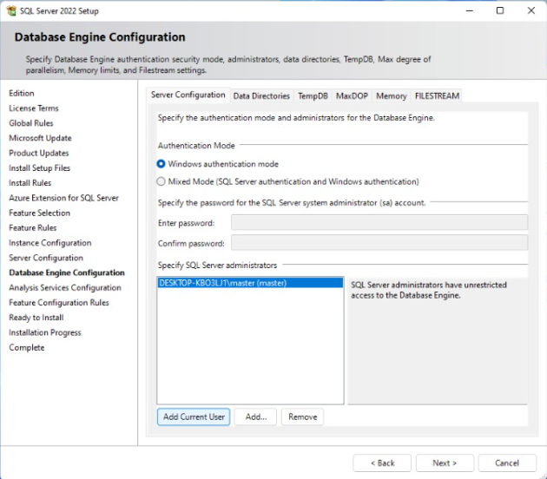

Slide 23
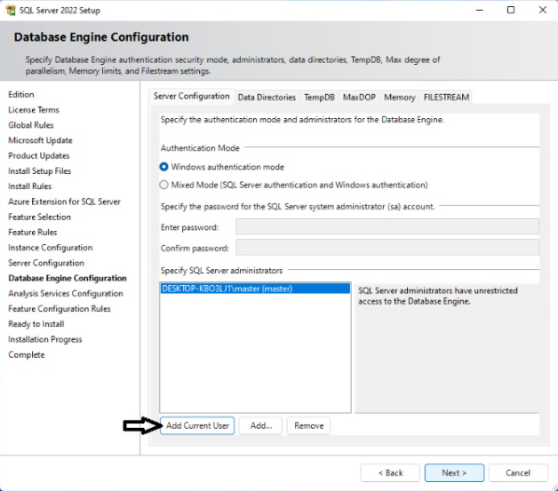

Slide 24
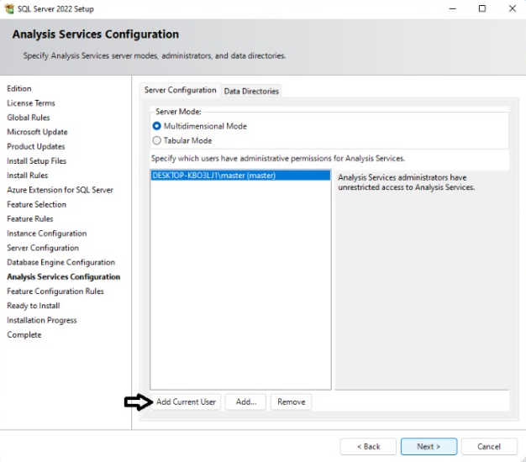

Slide 25
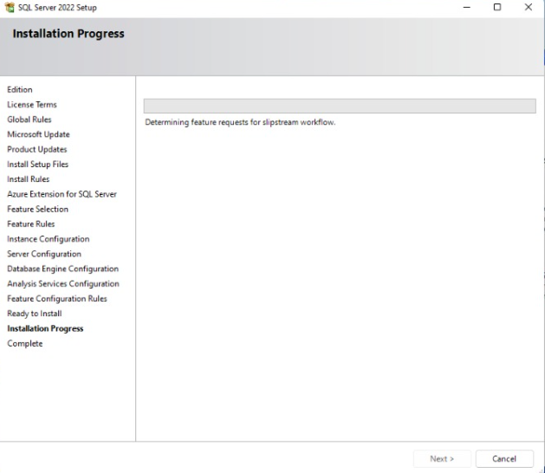

Slide 26
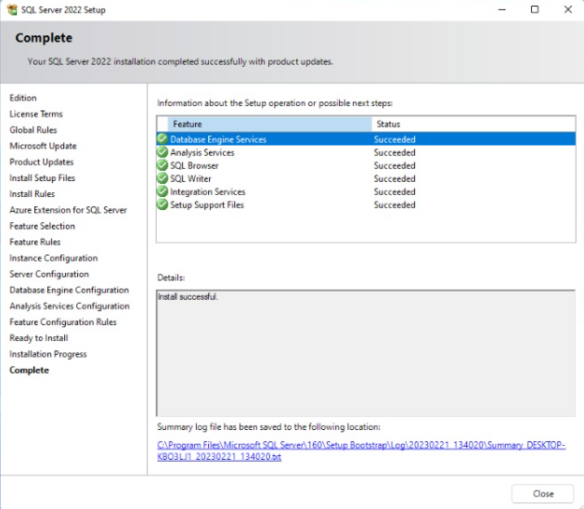

Slide 27
First task Creating an ASP.NET MVC Project

Slide 28
The section’s grades:
5 for quiz.
5 for practice.
20 for project.

Slide 29
The project requirements:
The team component of 6 members.
List of requirements in a software development project:
1. ERD of a database, implementation of models and relations in visual studio.
2. DB context and connection with database + migrations.
3. Login and Register page.
4. Add an image and store its path in the database.
5. ⁠Validation of all features.
6. ⁠CRUD operations for all essential entities.
7. ⁠Admin and user pages if they exist with Authorization.
8. Implement the website features of your idea.

Slide 30
Link of Microsoft teams
MVC group | SW and IS | Microsoft Teams

